Slide 1
Sparse Matrices
Collected by Ali Jafari

Slide 2
Let’s State A Problem
In social networks, often a form of an adjacency matrix is used to store the information about users that follow each other.

Slide 3

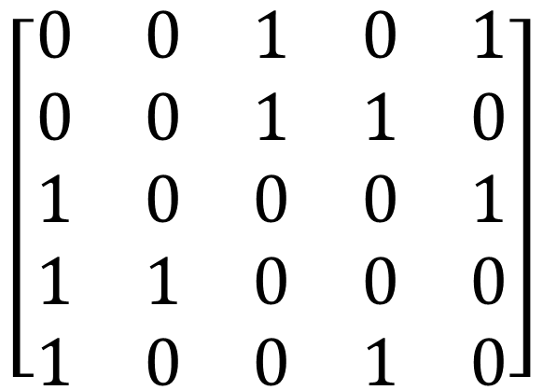

Let’s State A Problem
$$\begin{matrix}1 & 2 & 3 & 4 & 5\end{matrix}$$
$$\begin{matrix}1 \\ 2 \\ 3 \\ 4 \\ 5\end{matrix}$$
$$\left[\begin{matrix}0 & 0 & 1 & 0 & 1 \\ 0 & 0 & 1 & 1 & 0 \\ 1 & 0 & 0 & 0 & 1 \\ 1 & 1 & 0 & 0 & 0 \\ 1 & 0 & 0 & 1 & 0\end{matrix}\right]$$

Slide 4
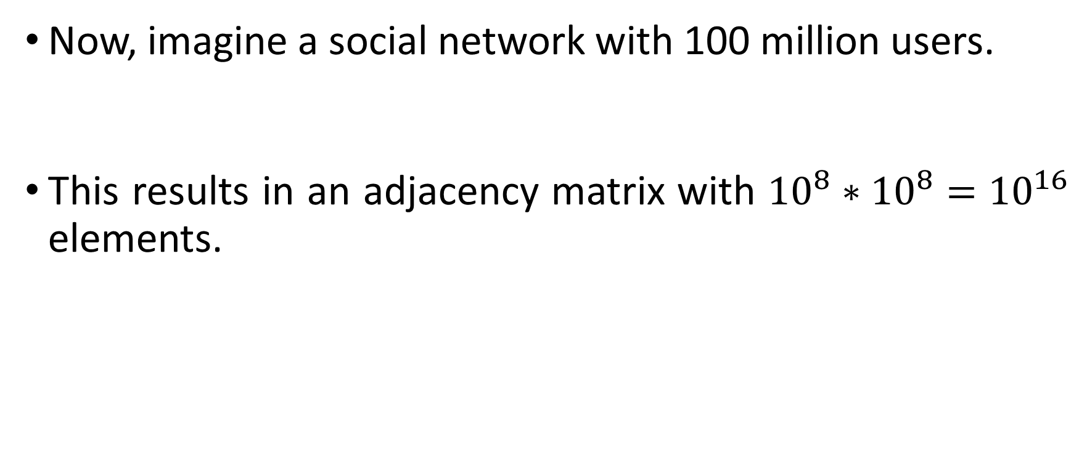
Let’s State A Problem
Now, imagine a social network with 100 million users.
This results in an adjacency matrix with ${10}^{8}∗{10}^{8}={10}^{16}$ elements.

Slide 5
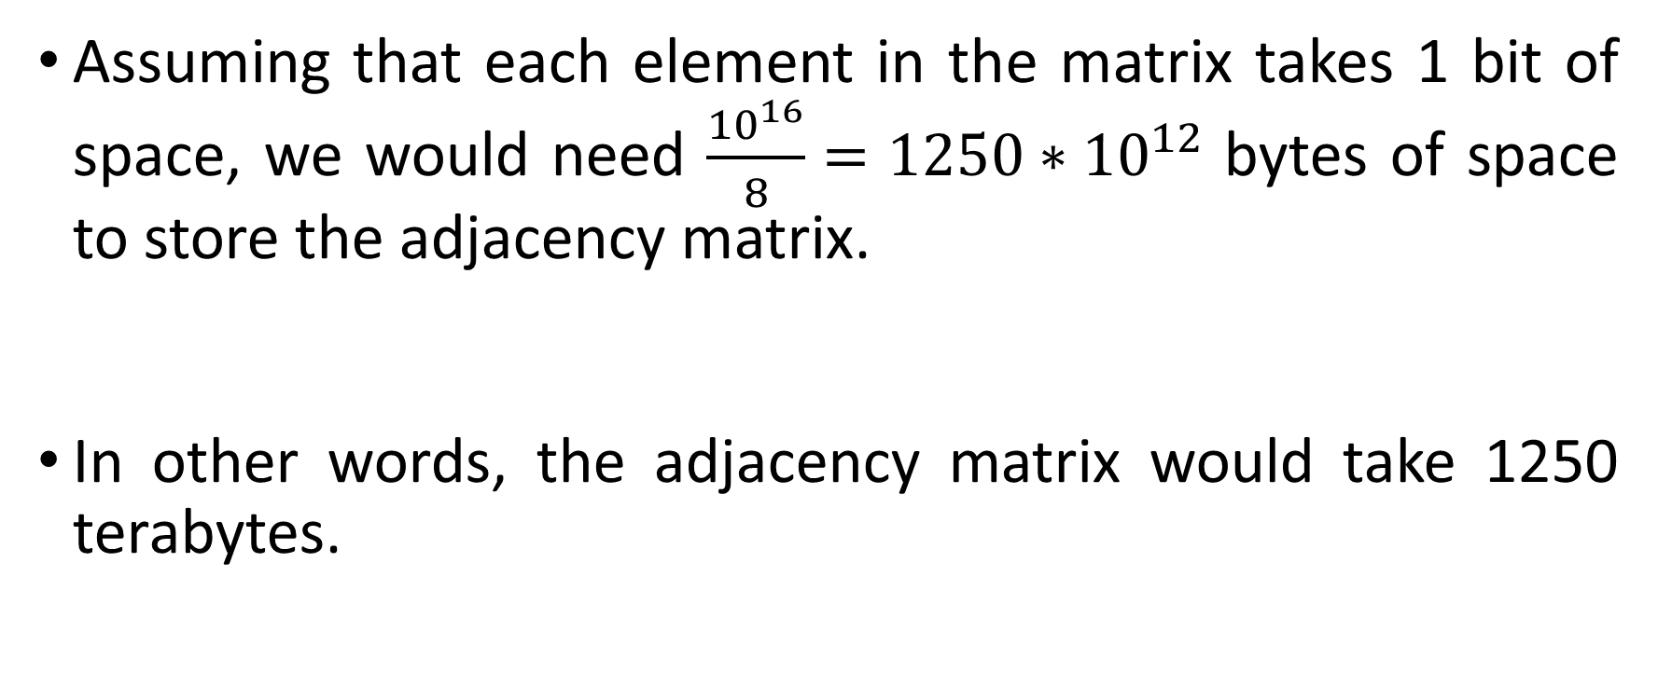
Let’s State A Problem
Assuming that each element in the matrix takes 1 bit of space, we would need $\frac{{10}^{16}}{8}=1250∗{10}^{12}$ bytes of space to store the adjacency matrix.
In other words, the adjacency matrix would take 1250 terabytes.

Slide 6
Let’s State A Problem
In reality, each user of a certain social network follows only a tiny fraction of the total users.
This means that most of the elements in the adjacency matrix are zero. In other words, the adjacency matrix is sparse.

Slide 7
What Are Sparse Matrices?
A sparse matrix is a matrix in which most of the elements are zero.
By contrast, if most of the elements in a matrix are non-zero, then the matrix is considered dense.

Slide 8
What Are Sparse Matrices?
There are no strict rules for the number of elements in a matrix that need to be zero in order to describe the matrix as sparse.
The number of zero-valued entries in a matrix, divided by the total number of entries in that matrix, is referred to as the sparsity of that matrix.

Slide 9
What Are Sparse Matrices?
“In practice, most large matrices are sparse — almost all entries are zeros.”
- Dr. Gilbert Strang, Introduction to Linear Algebra, 5th ed., Page 465.

Slide 10
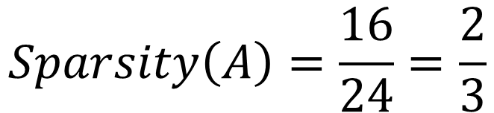
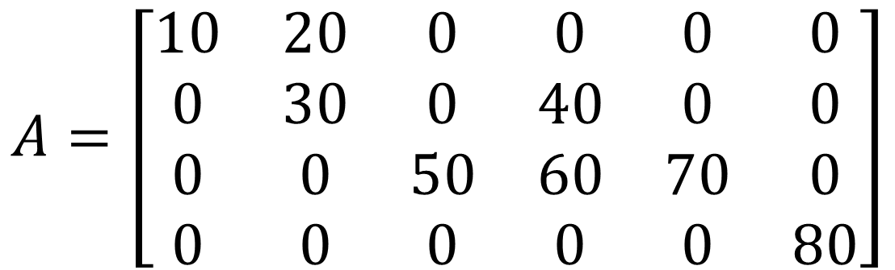
What Are Sparse Matrices?
$$A=\left[\begin{matrix}10 & 20 & 0 & 0 & 0 & 0 \\ 0 & 30 & 0 & 40 & 0 & 0 \\ 0 & 0 & 50 & 60 & 70 & 0 \\ 0 & 0 & 0 & 0 & 0 & 80\end{matrix}\right]$$
$$Sparsity\left(A\right)=\frac{16}{24}=\frac{2}{3}$$

Slide 11
Storing A Sparse Matrix
In the case of a sparse matrix, substantial memory requirement reductions can be realized by storing the non-zero entries only.

Slide 12
Storing A Sparse Matrix
Dictionary of Keys (DOK)
List of Lists (LIL)
Coordinate List (COO)
Compressed Sparse Row (CSR)
Compressed Sparse Column (CSC)

Slide 13
Dictionary of Keys (DOK)
DOK consists of a dictionary that maps (row, column)-pairs to the value of the elements.
Elements that are missing from the dictionary are taken to be zero.

Slide 14
Dictionary of Keys (DOK)
$$A=\left[\begin{matrix}10 & 20 & 0 & 0 & 0 & 0 \\ 0 & 30 & 0 & 40 & 0 & 0 \\ 0 & 0 & 50 & 60 & 70 & 0 \\ 0 & 0 & 0 & 0 & 0 & 80\end{matrix}\right]$$

Slide 15








Dictionary of Keys (DOK)
$$\left(0, 0\right) →10$$
$$\left(0, 1\right) →20$$
$$\left(1, 1\right) →30$$
$$\left(1, 3\right) →40$$
$$\left(2, 2\right) →50$$
$$\left(2, 3\right) →60$$
$$\left(2, 4\right) →70$$
$$\left(3, 5\right) →80$$

Slide 16
List of Lists (LIL)
LIL stores one list per row, with each entry containing the column index and the value.
Typically, these entries are sorted by column index for faster lookup.

Slide 17
List of Lists (LIL)
$$A=\left[\begin{matrix}10 & 20 & 0 & 0 & 0 & 0 \\ 0 & 30 & 0 & 40 & 0 & 0 \\ 0 & 0 & 50 & 60 & 70 & 0 \\ 0 & 0 & 0 & 0 & 0 & 80\end{matrix}\right]$$

Slide 18
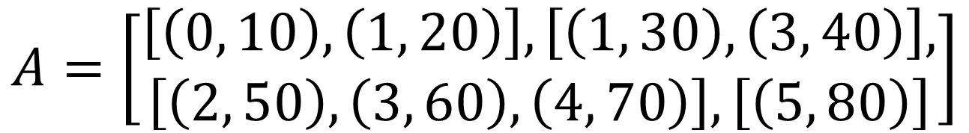
List of Lists (LIL)
$$A=\left[\begin{aligned}\left[\left(0, 10\right), \left(1, 20\right)\right], \left[\left(1, 30\right), \left(3, 40\right)\right], \\ \left[\left(2, 50\right), \left(3, 60\right), \left(4, 70\right)\right], \left[\left(5, 80\right)\right]\end{aligned}\right]$$

Slide 19
Coordinate List (COO)
COO maintains a list of row indices, a list of column indices, and a list of values for the non-zero entries in a sparse matrix.
The entries of the matrix are sorted first by row index and then by column index, to improve random access time.

Slide 20
Coordinate List (COO)
$$A=\left[\begin{matrix}10 & 20 & 0 & 0 & 0 & 0 \\ 0 & 30 & 0 & 40 & 0 & 0 \\ 0 & 0 & 50 & 60 & 70 & 0 \\ 0 & 0 & 0 & 0 & 0 & 80\end{matrix}\right]$$

Slide 21

Coordinate List (COO)
$$VALS=[10, 20, 30, 40, 50, 60, 70, 80]$$
$$COLS=[0, 1, 1, 3, 2, 3, 4, 5]$$
$$ROWS=[0, 0, 1, 1, 2, 2, 2, 3]$$

Slide 22
Compressed Sparse Row (CSR)
The compressed sparse row (CSR) format represents a matrix by three lists, that respectively contain values, the extents of rows, and column indices for the non-zero entries.
It is similar to COO, but compresses the row indices, hence the name.

Slide 23
Compressed Sparse Row (CSR)
$$A=\left[\begin{matrix}10 & 20 & 0 & 0 & 0 & 0 \\ 0 & 30 & 0 & 40 & 0 & 0 \\ 0 & 0 & 50 & 60 & 70 & 0 \\ 0 & 0 & 0 & 0 & 0 & 80\end{matrix}\right]$$

Slide 24

Compressed Sparse Row (CSR)
$$VALS=[10, 20, 30, 40, 50, 60, 70, 80]$$
$$COLS=[0, 1, 1, 3, 2, 3, 4, 5]$$
$$ROWS=[0, 2, 4, 7, 8]$$

